Slide 1

creating a movement
Let’s Loop Seattle

Slide 2
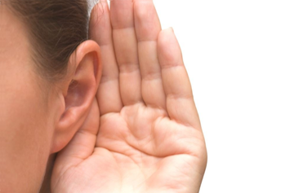
1,000’s of venues across Puget Sound have little or no hearing access

Slide 3
Tens of thousands of people with hearing loss miss out
  causing careers to stall
  decreasing civic and volunteer involvement
  attending events with friends and family
  and can become isolated and depressed
  All because they can’t hear clearly

Slide 4
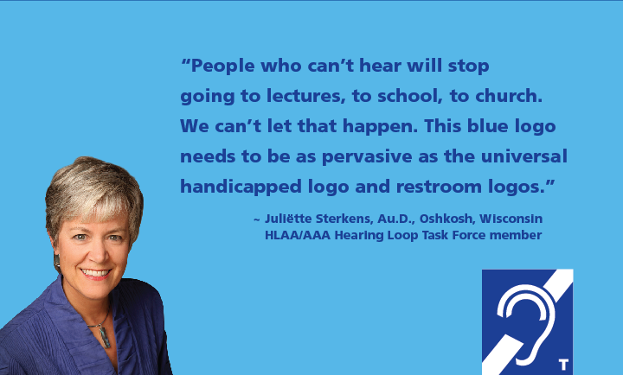
What do you want the world to be like?

Slide 5
Break down barriers
employment
government programs and services
public accommodations
entertainment
telecommunications
education
transportation
Share
the sound!

Slide 6
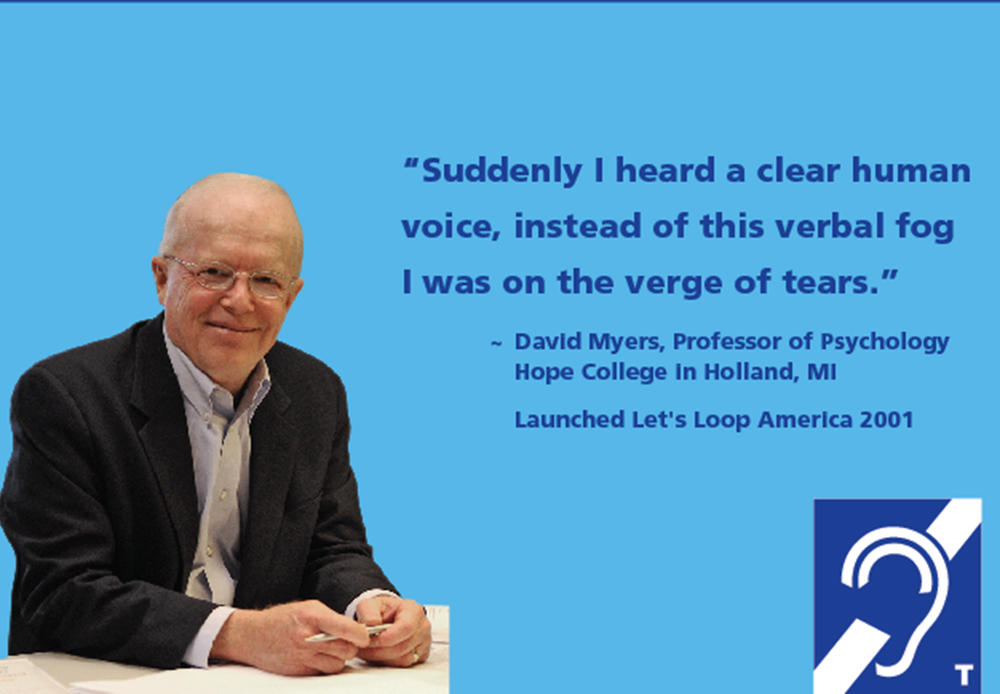
Loop America Launched in 2001
Dr. Myers first used a hearing loop at Iona Abbey in Scotland
hearingloop.org

Slide 7
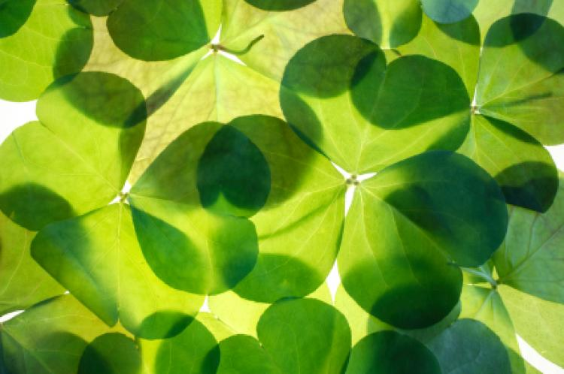
Shared Stories
My story began in Ireland, hearing through a loop for the first time
I knew I had to share this technology with as many people with hearing loss as possible
Cheri Perazzoli, Director of Advocacy, HLAA-WA

Slide 8
Our Stories Mirrored
Met Dr. Myers at the HLAA Convention 2011

Slide 9

Let’s Loop Seattle was founded to
raise awareness
guide venues
support hearing access across Puget Sound

Slide 10
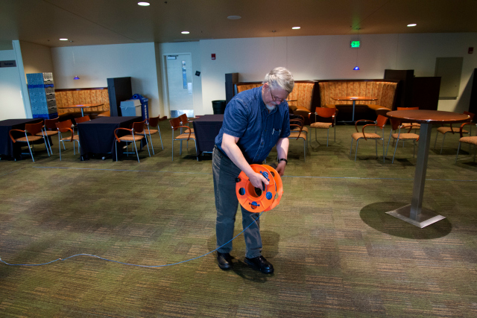
Hearing loops are
discreet
the most used hearing access technology
unparalleled in providing understanding for people with hearing loss

Slide 11
The Vision
  Create awareness about hearing loss
  Support barrier-free hearing access
  Create a culture where hearing loss is acknowledged and hearing aid use is encouraged

Slide 12
Accessible
Communities
Imagine the next 50 years living in a community designed for engagement and accessibility, where all people can gather and join the conversation

Slide 13
Develop a Communications Plan
Collateral
Website
Social media, Twitter, FB,
  Instagram, Pinterest, LinkedIn
Blog

Slide 14
creating accessible communities

Slide 15
Think sideways to find a way in
Installed a temporary loop in Seattle Center’s Rainier Room
Inspired Stroum Jewish Community Center to include loops in their funding request!
Educated Seattle’s change makers, started a conversation

Slide 16
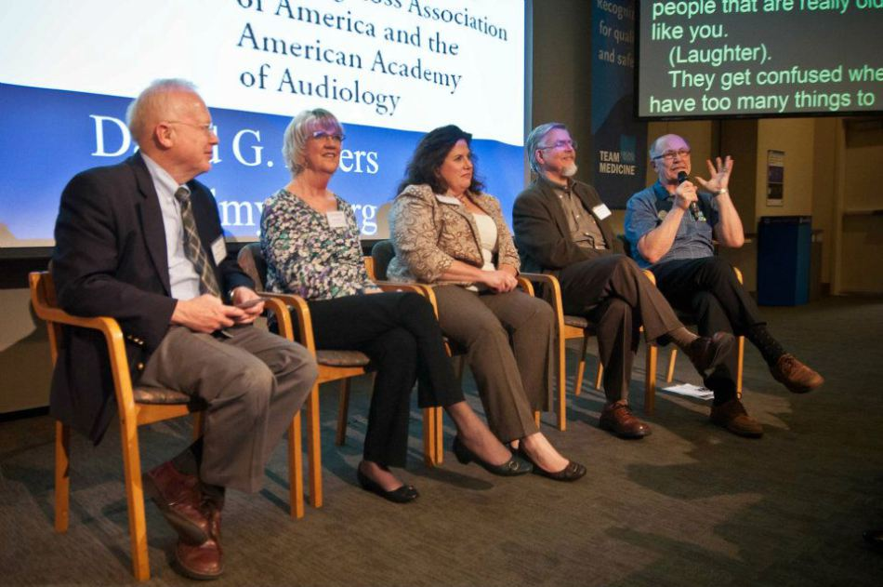
Grow a movement, feed the fire
Collaborate with Others…

Slide 17
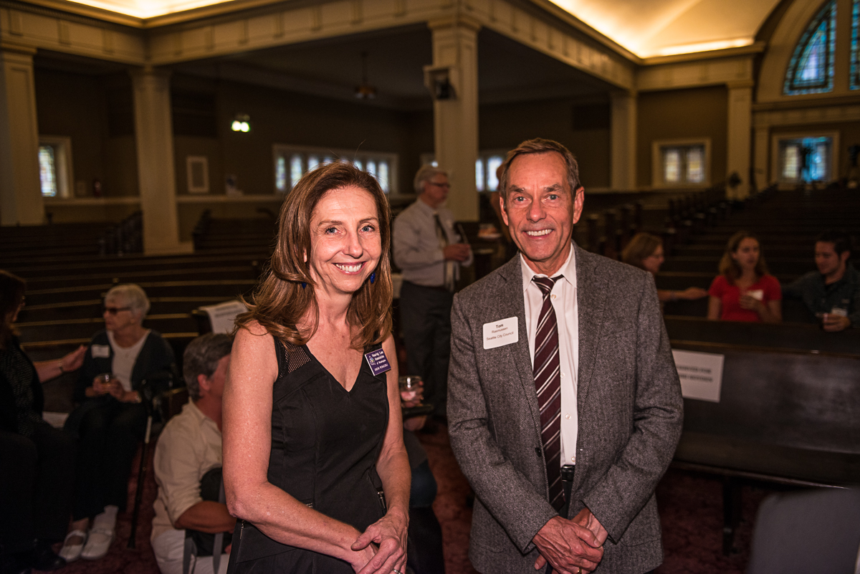
Build Relationships
Everyday people who need help
Similar organizations:
  Hearing, Speech, & Deafness Center
  University of Washington Audiology
  WA Office of the Deaf & Hard of Hearing
  NW Universal Design Council
  Washington Access Fund
Movers, shakers, thought leaders, donors

Slide 18
Success breeds success
More and more loops being installed
city council chambers
libraries
theatres
senior residence communities

Slide 19
Create Ambassadors
Once someone’s heard through a loop, they often become an ambassador
Maggie Buckholz, library manager, not only installed a loop but now advocates for MORE loops

Slide 20
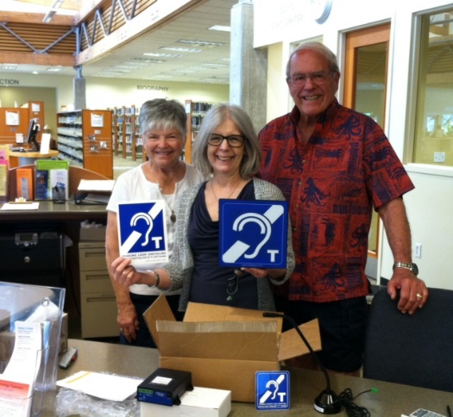
Ambassadors

Slide 21
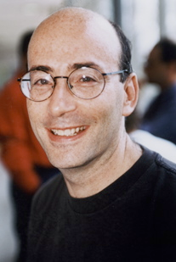
Putting a Face on Hearing Loss
I experienced the euphoria as I sat alongside 600 people at the looped Wicked performance at Kennedy Center
“There I was at Wicked, weeping uncontrollably—and I don’t even like musicals. For the first time since I lost most of my hearing, live music was perfectly clear, perfectly clean, and incredibly rich.”
Richard Einhorn, composer

Slide 22
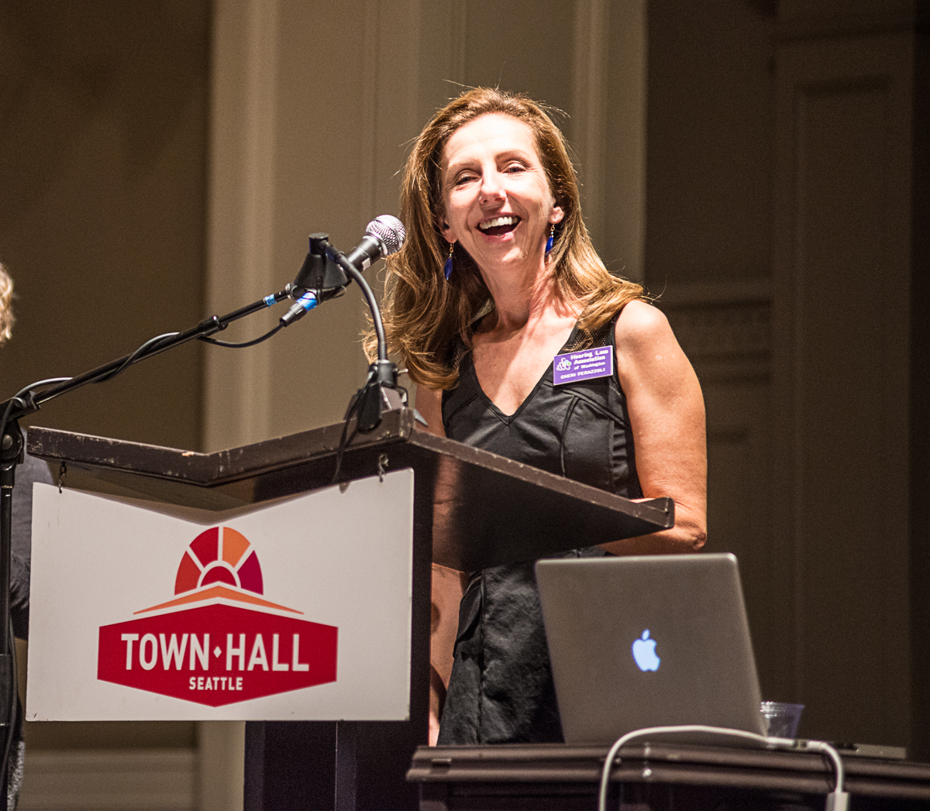
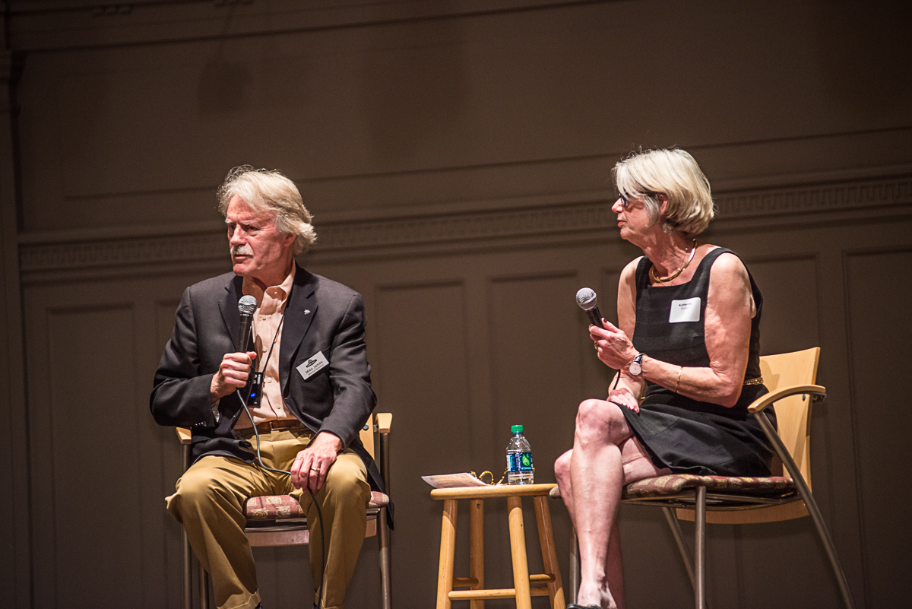
Town Hall Seattle Installs Loop
Launch party increases awareness

Slide 23
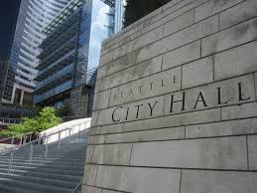
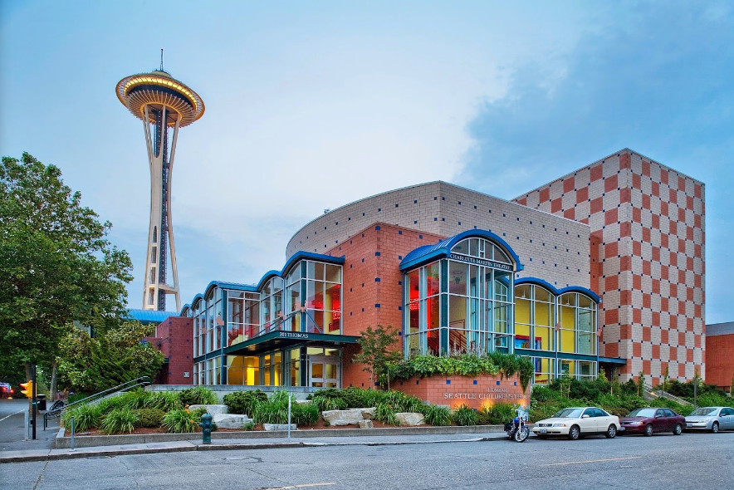
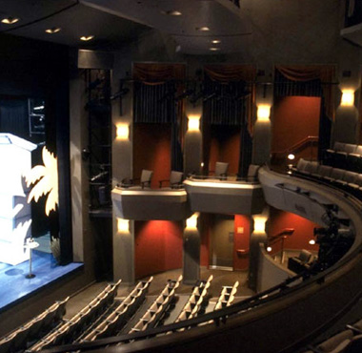
Follow the Leaders
City Council
Seattle
Children’s Theatre
Seattle Rep

Slide 24
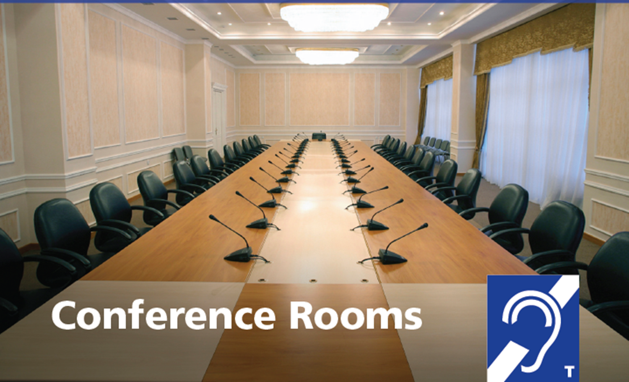
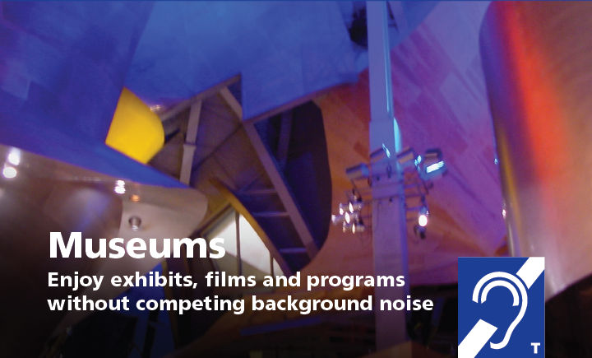
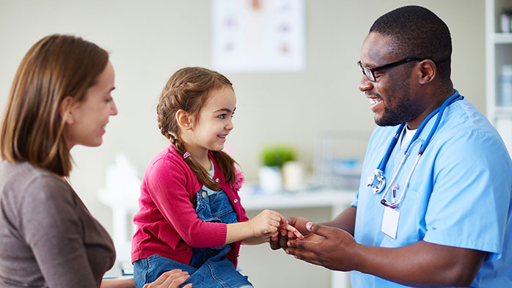
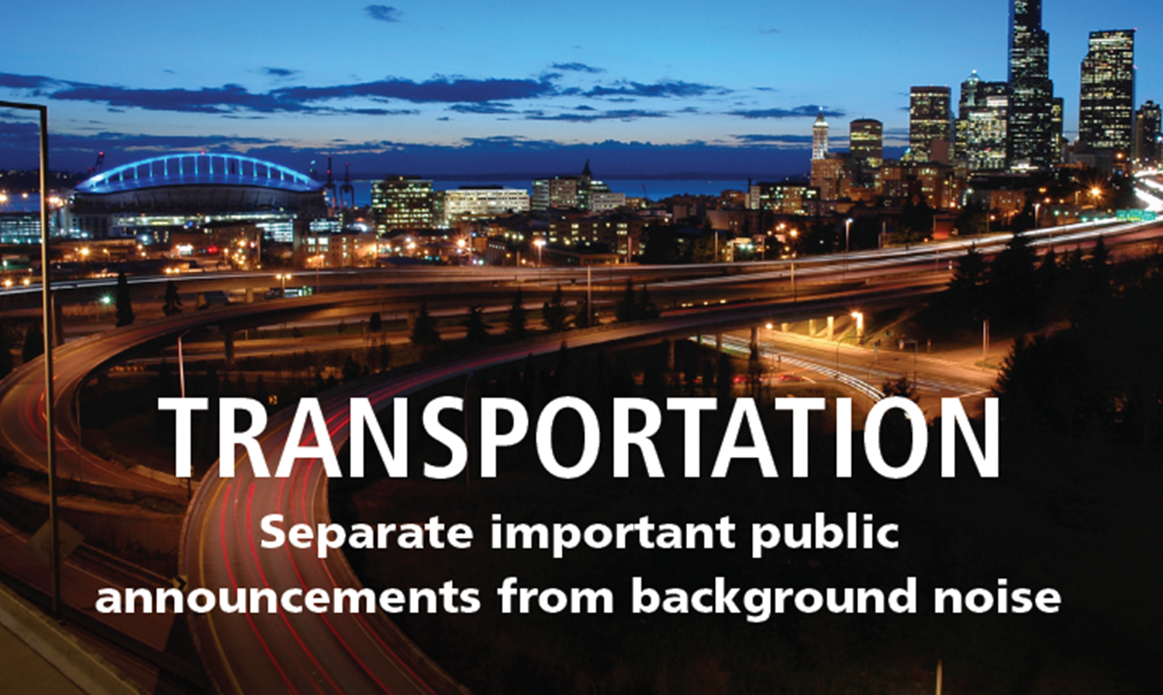
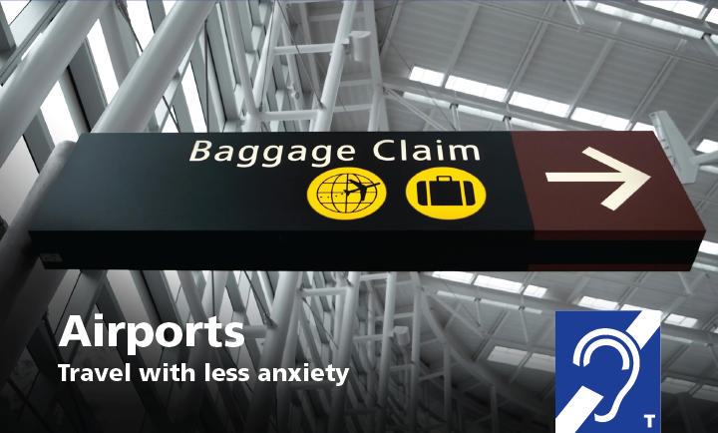

Where else can loops go?
Health Care

Slide 25
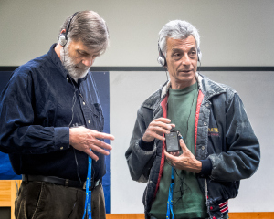
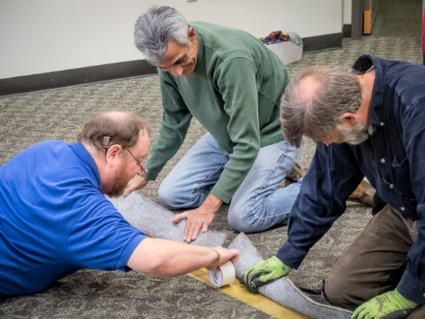
Follow-up with venues
  Signage
  Testing
  Maintenance
  Staff Training
  Marketing

Slide 26
ASK
Fish where the fish are

Slide 27
$$$
Funds are available if you look
  4Culture, Seattle
  Washington Access Fund
  Theatre Development Fund
  Equipment grants & private foundations
  State, local, county, federal programs
  Thought leaders, business, arts, cultural
  Private donors

Slide 28
Persistence
Expect setbacks
Think laterally
When in doubt, collaborate!

Slide 29




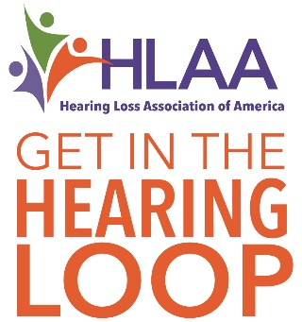
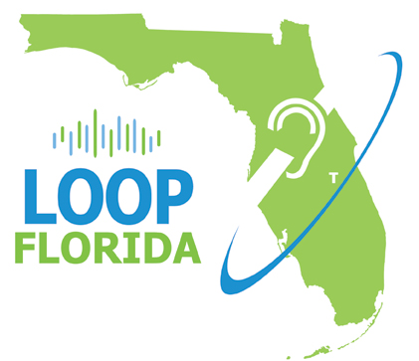



The fire spreads

Slide 30
More Information
Let’s Loop Seattle www.loopseattle.org
Loop America
http://www.hearingloop.org
HLAA-WA
hearingloss-wa.org
Cheri Perazzoli
access@hearingloss-wa.org

