Slide 1
FUNdraising and creating a movement
Let’s loop seattle’s lessons learned

Slide 2
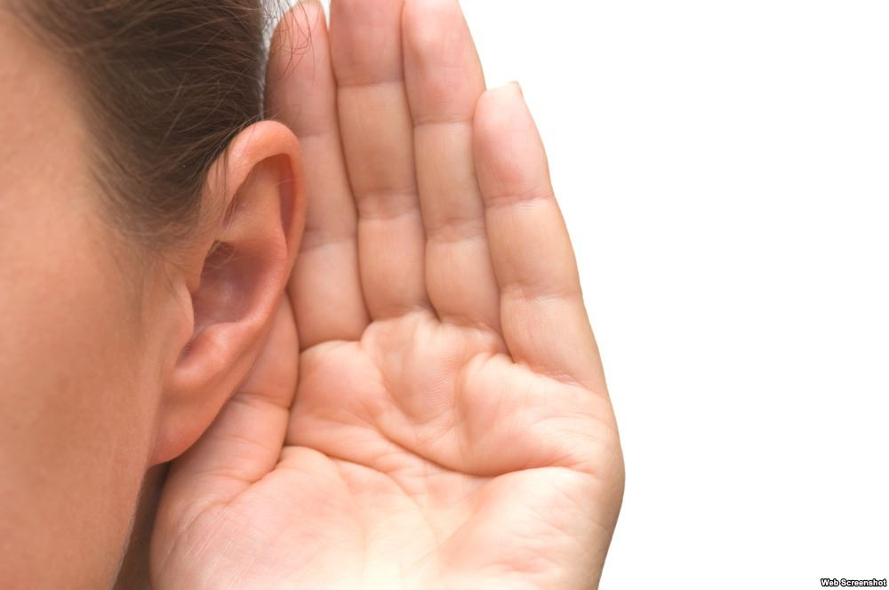
Define the problem: people miss out, but loops help
Thousands of venues across Puget Sound have little or no hearing access
Tens of thousands of people with hearing loss miss out
  Many simply stay home because they can’t hear clearly
  Careers are stalled
  Service suffers and slows down
  Civic, volunteer involvement decreases
  Precious time and events with friends, family are lost
  People with hearing loss can become isolated, depressed

Slide 3

Tell them who you are: We are LLS. We are legion!
Let’s Loop Seattle was founded to raise awareness, guide venues, support hearing access across Puget Sound
Share the sound! Break down barriers to employment, transportation, government services, telecommunications, entertainment

Slide 4

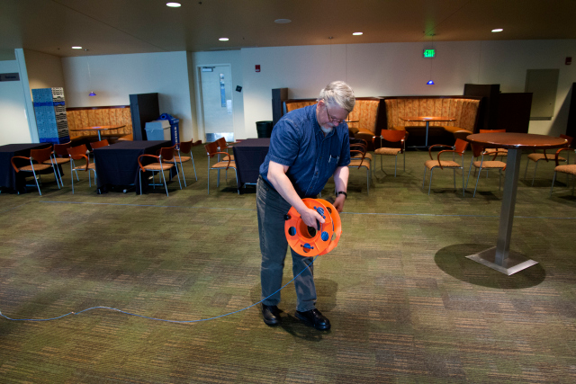
Think sideways to find a way in
In 2013, I gave a PechaKucha talk
Installed a temporary loop in Seattle Center’s Rainier Room
Inspired Stroum Jewish Community Center to include loops in their funding request!
Informed Seattle’s change-makers, started conversation

Slide 5
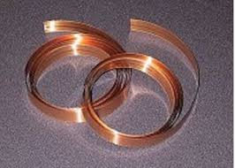
What am I giving to, exactly?
Let people know just what a loop is
The discreet, well-loved, most-used, most-powerful hearing access technology
A simple copper wire around a space, room, or counter
Feeds into PA system/microphone
Sends sound directly to a user’s hearing aid or CI, customized to users
Unparalleled communication and comprehension for people with hearing loss

Slide 6
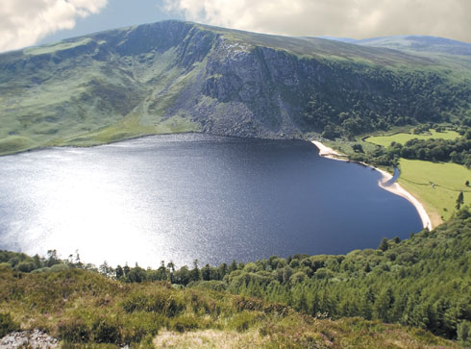
Personal stories draw people in
My story began in Ireland, hearing through a loop for the first time
I knew I had to bring this technology back home to as many people as possible
The power of one story can move hearts--and mountains

Slide 7
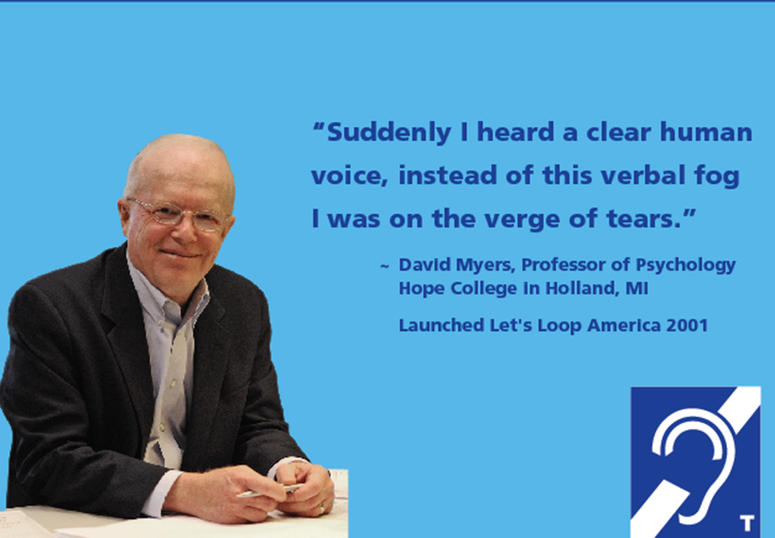
One story connects, ignites others
I met Dr. David Myers, at the 2011 HLAA convention, and our stories mirrored
Dr. Myers launched Loop America
Message, voice are amplified

Slide 8

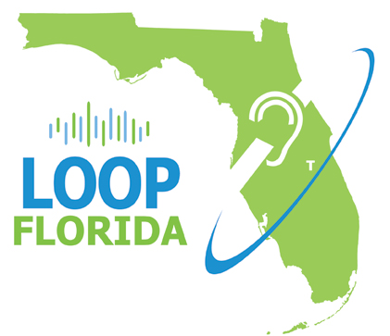


The fire spreads

Slide 9
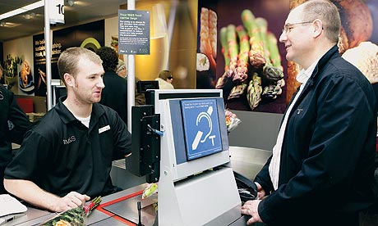
Develop a clear, compelling vision
Let’s Loop Seattle aims to….
  Create awareness about hearing loss
  Support barrier-free hearing access
  Create a culture where hearing loss is acknowledged and hearing aid use is encouraged
  Imagine the next 50 years living in a community designed for engagement and accessibility, where all people can gather and join the conversation

Slide 10
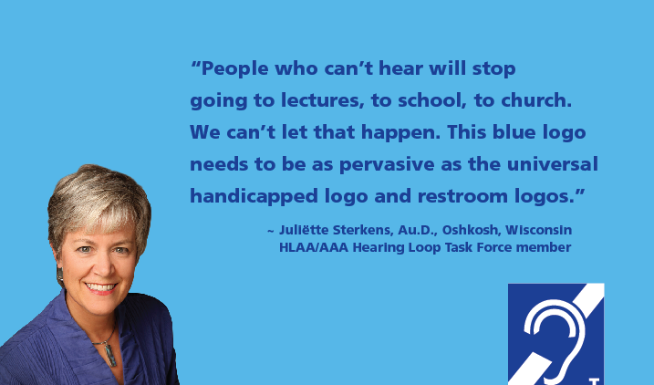
What do you want the world to look like?

Slide 11
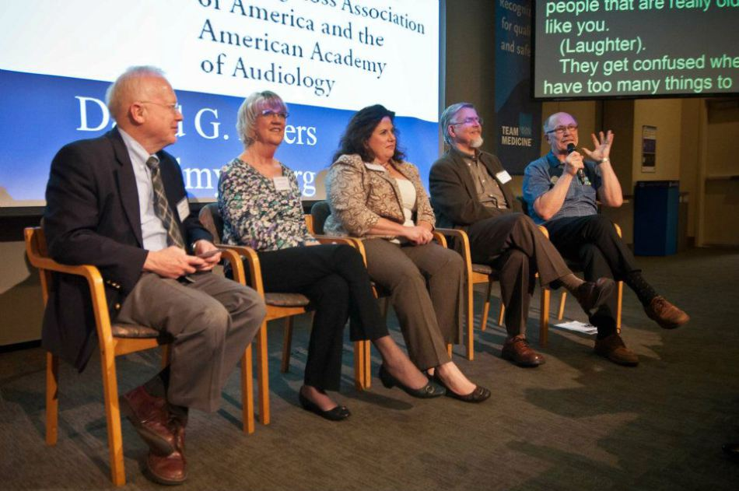
Grow a movement, feed the fire
Draw your resources around you, beginning with supporters
Who is on your team?
Launch party – create festive atmosphere

Slide 12
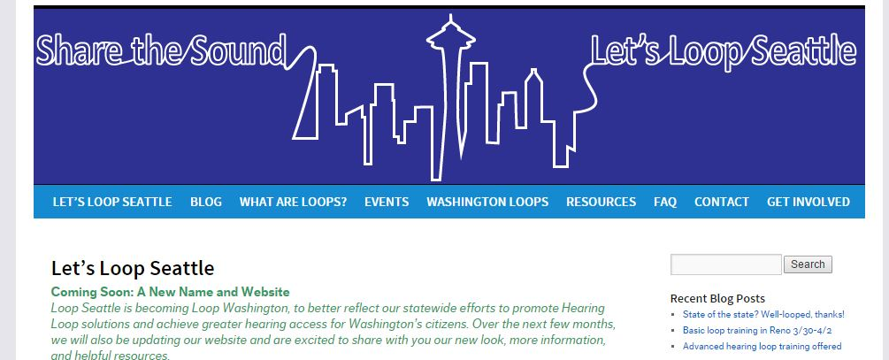
Develop a communications plan
Website
Collateral
Social media
(Twitter, FB, Instagram,
Pinterest, LinkedIn)
Blog
Paid help, if you can

Slide 13
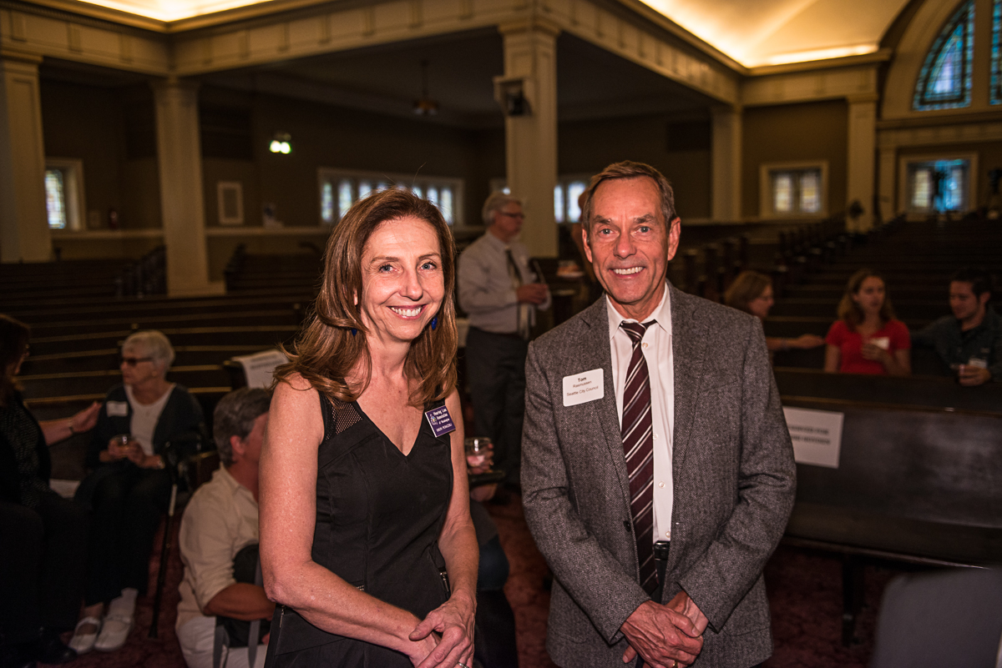
Build relationships
Movers & shakers; thought leaders
Donors
Everyday people who need help
Similar organizations
  Hearing, Speech, & Deafness Center
  University of Washington Audiology
  Office of the Deaf & Hard of Hearing
  (State of Washington)
  NW Universal Design Council
  Washington Access Fund

Slide 14
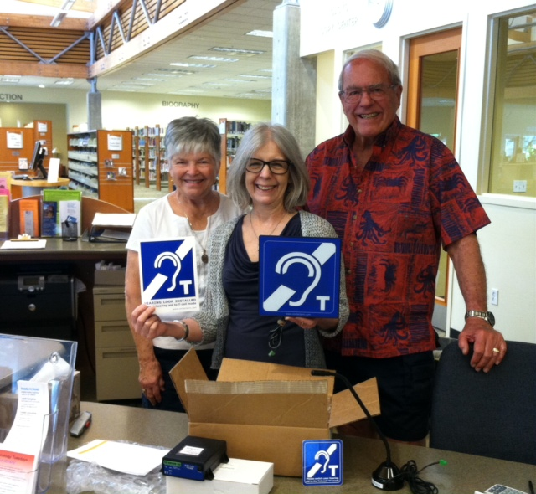
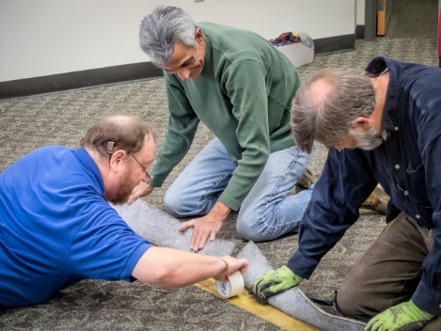
Success brings more success
More and more loops being installed
Bellevue Library, Burlington Library, churches

Slide 15
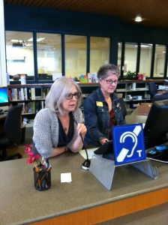
Create ambassadors
Once someone’s heard through a loop, they often become an ambassador
Maggie Buckholz, library manager, not only installed a loop but now advocates for MORE loops

Slide 16
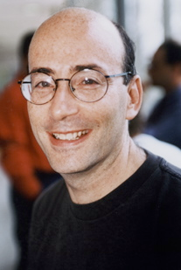
Personal testimonials put a face on hearing loss
I experienced the euphoria as I sat alongside 600 people at the looped Wicked performance at Kennedy Center
“There I was at ‘Wicked,” weeping uncontrollably—and I don’t even like musicals. For the first time since I lost most of my hearing, live music was perfectly clear, perfectly clean, and incredibly rich.” --Richard Einhorn, composer

Slide 17
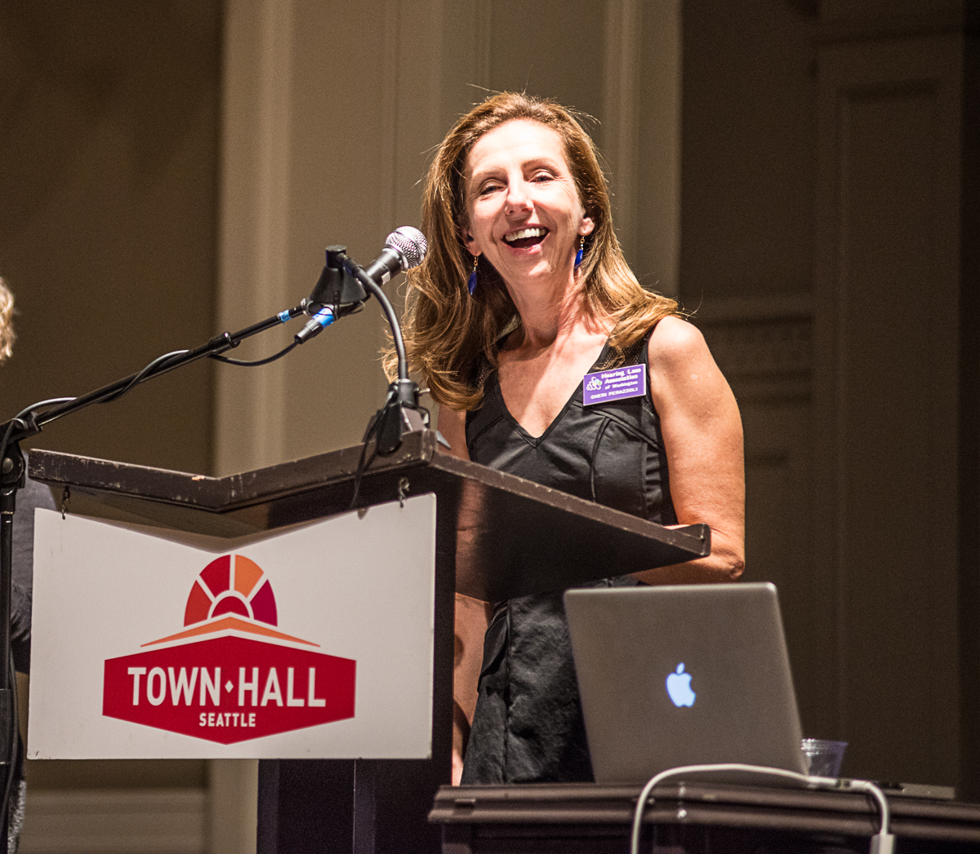
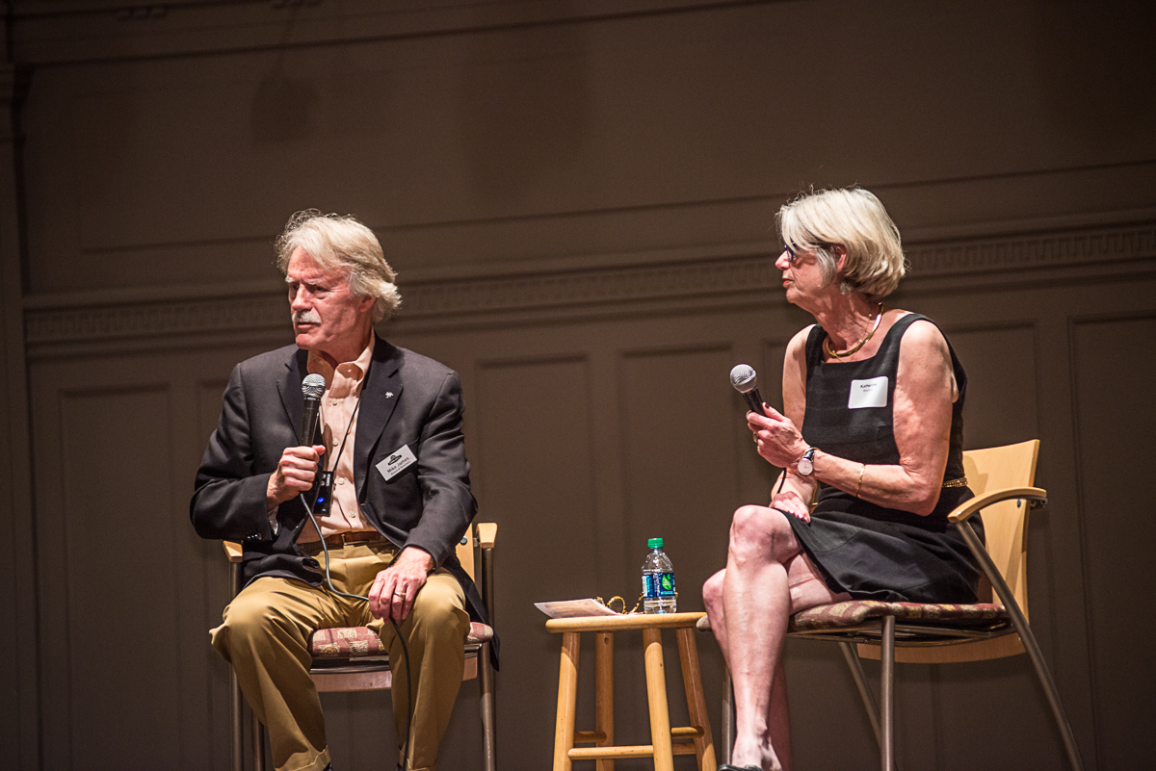
Transformational projects
Town Hall Seattle installs loop
Launch party
Catapults to new levels of awareness,
victories, donations

Slide 18
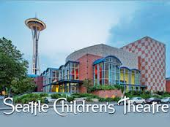
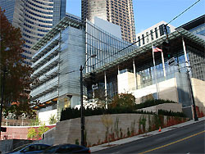
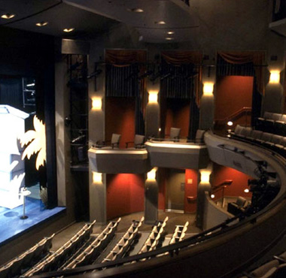
Following the leader
Loops now being considered at Seattle Rep, Seattle Children’s Theatre, plus city councils

Slide 19
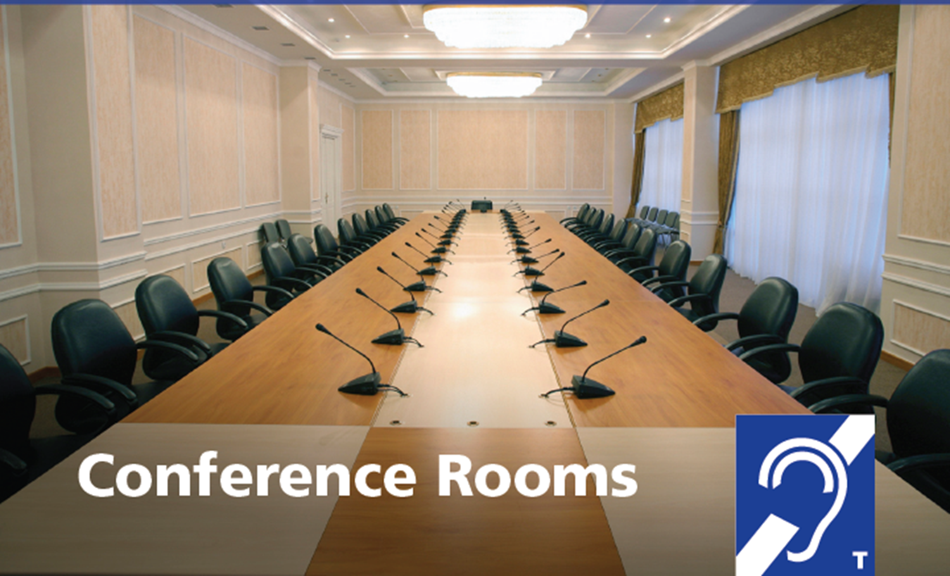
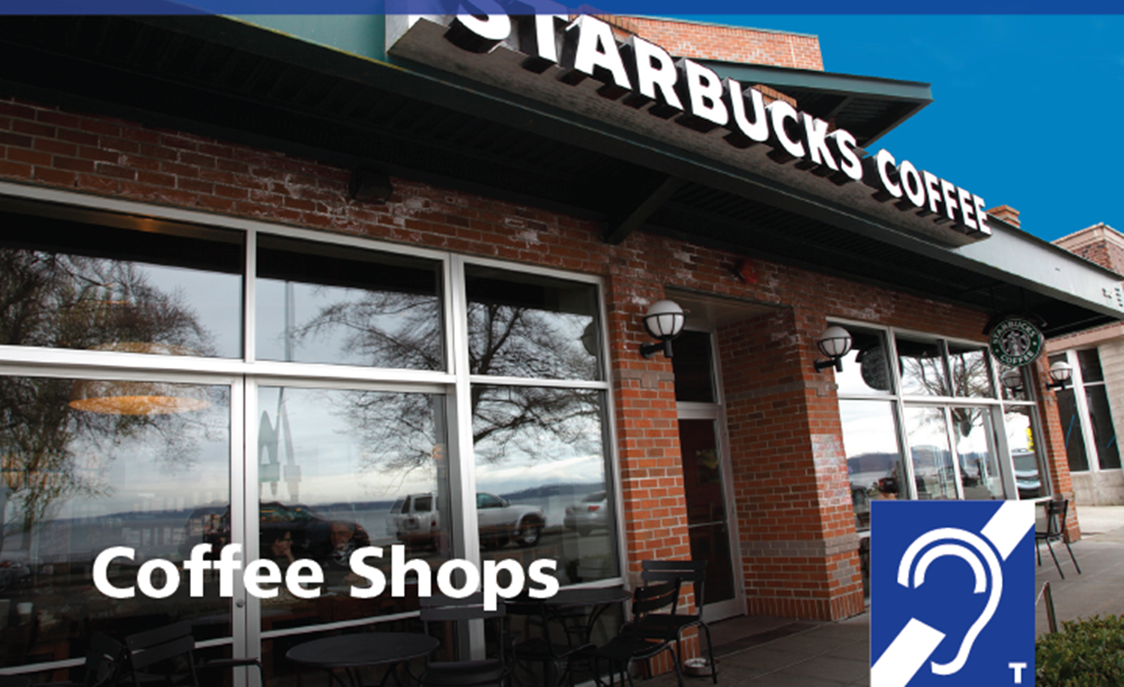
Where else can loops go?

Slide 20
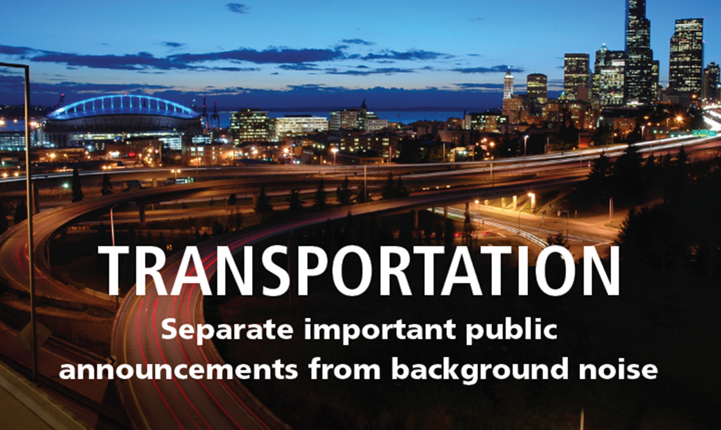

Where else can loops go?

Slide 21

Fish where the fish are
Funds are available if you look
  4Culture (Seattle)
  Washington Access Fund
  Theatre Development Fund (www.tdf.org)
  Equipment grants
  Private foundations
  State, local, county, federal programs
  Private individuals
  Thought, business, arts, cultural leaders
  Who do you know who’s been impacted by hearing loss?

Slide 22
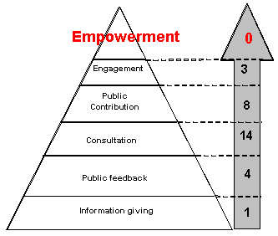
Ask for support, help, engagement
Ask HLAA members and your constituents
  Make access requests
  Write letters
  Thank venues who provide access
  Connect via social media
GiveBIG, Seattle’s one-day give-fest

Slide 23
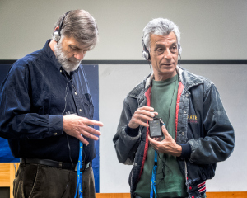
Persistence
Expect setbacks
Think laterally
When in doubt, collaborate!
Follow-up with venues
  Signage
  Testing
  Maintenance
  Staff training
  Marketing

Slide 24
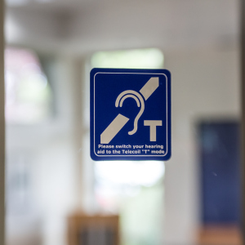
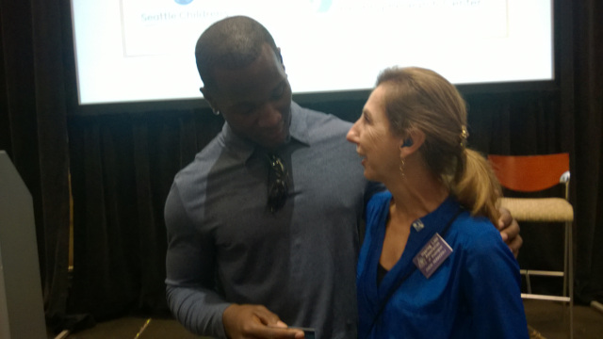
For more information
Cheri Perazzoli (cheripz@gmail.com)
Let’s Loop Seattle (www.loopseattle.org)
Loop America
HLAA-WA (hearingloss-wa.org)

