Slide 1


Networking to get the hearing access you need
Cheri Perazzoli
Let’s Loop Seattle founder
HLA-WA trustee

Slide 2
Hearing loss help is at hand
The Hearing Loss Association of Washington and Hearing Loss Association of America are here to serve YOU
Nonprofit, founded by people with hearing loss
HLA-WA volunteer-led, holds local support groups
Let’s Loop Seattle is initiative of HLA-WA
Advocacy, information, education, support groups, policy

Slide 3
City of Bellevue
Diversity : the who
Jennifer Mechem, ADA/Title VI Program Administrator: jmechem@bellevuewa.gov (our go-to; she has a hearing loss)
Mark Manuel, Diversity Outreach and Engagement Administrator, mmanuel@bellevuewa.og
Elaine Acacio, Diversity and Inclusion Program Administrator, eacacio@bellevuewa.gov

Slide 4
Bellevue’s Diversity Advantage Plan: the what
Adopted in 2014 via Resolution 8856
Voices of Diversity television program, video
Cultural events, business events, workshops
May 21, 8-4, Bellevue Neighborhoods Conference at Bellevue City Hall
https://www.bellevuewa.gov/cultural_diversity.htm?print=true
For the plan PDF: http://www.ci.bellevue.wa.us/pdf/Parks/Bellevue_Diversity_Advantage_Plan_12-08-14.pdf

Slide 5
Making the ask
ADA formal request—they are required to respond
Letter (attached)
Ask for specifics: Will a microphone be used? Is the room looped? If not, do they have an Assistive Listening System? Does the ALS have both headsets and neck loops? other?) Will there be CART Captioning?
Start positive and polite; assume they want to help
Circle back with a thank you directly (also Tweet, FB, deafreview.com)

Slide 6
Requests = more requests, which means more access
Diana laid groundwork
Cheri speaking led to more access

Slide 7
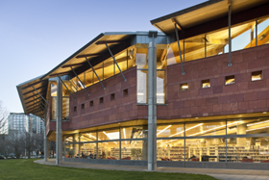
Best hearing access in Bellevue: the where
Bellevue Library Meeting Room 1
Upcoming Looped programs
May 21, 1pm – Being Asian in America with Sam Louie
May 31, 6pm – Your Business: Market Smart
June 14, 6pm – Your Business: Operate Smart
June 22, 6:45 pm - Color: A Night of Coloring for Grown-Ups
June 27, 2 pm - Team Up for Funny Folktales and Race to Read Show
Bellevue Friends of the Library
http://bellevuefriends.org/bfol.asp
questions@bellevuefriends.org
Bellevue Friends of the Library Co-Sponsored Program
June 3, 6:30 pm – Film + Fashion with Film Historian Lance Rhoades
http://www.bellevuearts.org/calendar/event/06_03_Film_Fashion.html

Slide 8
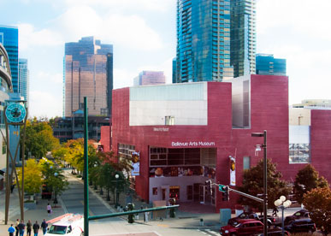
Best hearing access in Bellevue: the where
Bellevue Arts Museum
Auditorium and counter
Looped
May 31, 7pm - Loggia Lectures with Rob Prufer—Gaining Access to America's Galleries: The Remarkable 1976 Traveling Exhibition Two Centuries of Black American Art
June 3, 6:30 pm – Film + Fashion with Film Historian Lance Rhoades
http://www.bellevuearts.org/calendar/event/06_03_Film_Fashion.html
Free. RSVR required:
http://www.bellevuearts.org/calendar/rsvp.html
June 11, 12 noon - Tour + Talk: Bren Ahearn
June 15, 6:30 pm - Artist Talk: Seth Rolland
June 22, 6:30 pm - Kitchen Sessions: Inspiring Beauty, Curated by Imani Sims

Slide 9
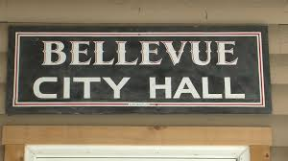
Best hearing access in Bellevue: the where
Bellevue City Council
Chambers
Room 1E-113
Looped
May 21, 8 -4 - Bellevue Neighborhoods Conference
http://www.bellevuewa.gov/12237.htm
The council meets on the first four Mondays of each month at City Hall, 450 110th Ave. NE. Comments from the public are welcome during the "Oral Communications" portion of the agenda and during public hearings.

Slide 10
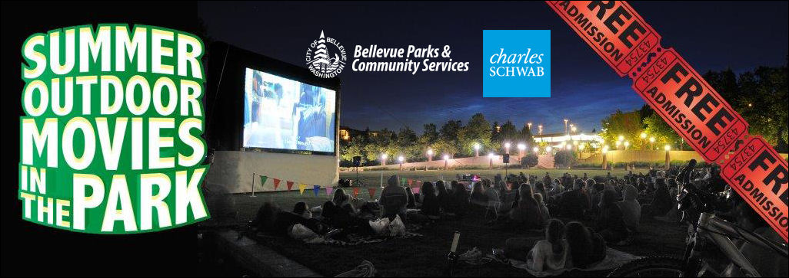
Best hearing access in Bellevue: the where
Bellevue Outdoor Movies
http://bellevuewa.gov/outdoor-movies.htm
Hidden Valley Sports Park
1905 NE 112th St.
Request that captions be turned on!

Slide 11
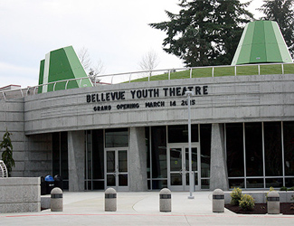
Best hearing access in Bellevue: the where
Bellevue Youth Theatre
looped
June 5, 3pm – Rhythms of India Dance
June 8, 2pm - "Chairs”: Silver Kite’s Intergenerational Theatre Company Performance
May 13 – 22 - Beauty and the Beast

Slide 12
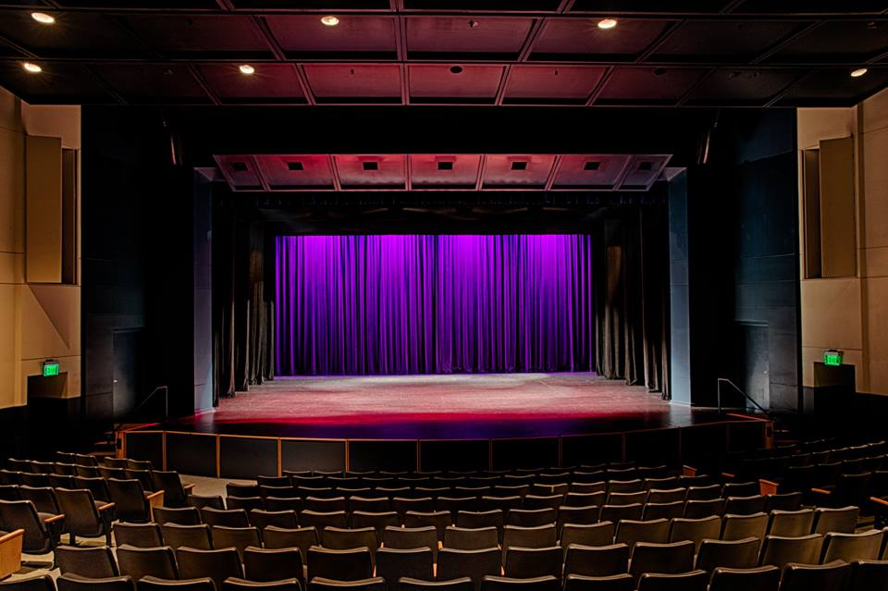
Best hearing access in Bellevue: the where
Meydenbauer Center Theatre
Looped
May 20-22 – Don Quixote by the International Ballet Theatre
June 10 7pm – The Hope Show (dance)
June 19 – La Luna Kiss with World Rhythmic Gymnastics
June 27 – Detlef Schrempf Celebrity Gala, Auction
http://www.meydenbauer.com/attend/event/

Slide 13
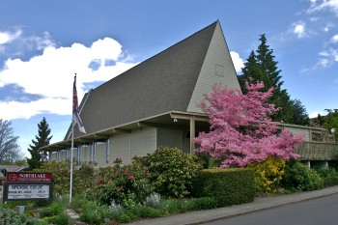
Best hearing access in Puget Sound: the where
Meaningful Movies
Northlake Unitarian Universalist Church
308 4th Ave S
Kirkland
http://northlakeuu.org/committees/communications-committee/
http://northlakeuu.org/contact-us/
425-882-0171
Every third Friday of the month at 7pm
May 20 , 7pm – Just Eat It

Slide 14
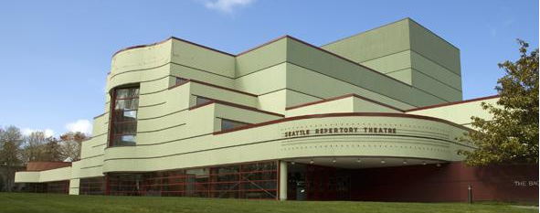
Best hearing access in Puget Sound: the where
Seattle Repertory Theatre (the Rep)
Leo K
Bagley Wright
both looped
Thru May 22 – Sherlock Holmes and the American Problem
Thru May 22 – A Rap on Race
Starting September 30 – A Raisin in the Sun
http://www.seattlerep.org/About/Contact/Feedback
Subscriptions now on sale for 2016-2017
season. https://www.seattlerep.org/Plays/1617/

Slide 15
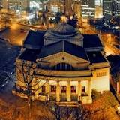
Best hearing access in Puget Sound: the where
Town Hall Seattle
Looped in Great Hall and Downstairs
https://townhallseattle.org/
https://townhallseattle.org/membership/
For patrons who are hard of hearing:
https://townhallseattle.org/plan-your-visit/#tabs-visit-tab-10

Slide 16
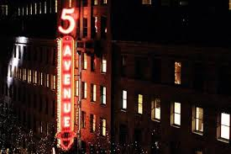
Best hearing access in Puget Sound: the where
Fifth Avenue Theatre
ALS: Infrared; Neck Loops and Headsets available at Coat Check
Open Captioned shows
June 11, 2pm – Paint Your Wagon
July 21, 8 pm – A Gentleman’s Guide to Love & Murder
https://www.5thavenue.org/

Slide 17
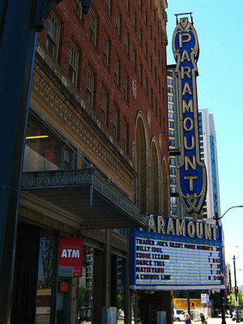
Best hearing access in Puget Sound: the where
Paramount Theatre
Open captioned shows
ALS: Infrared: Headsets and Neck Loops
May 1, 2016, 6:30 pm – Newsies
June 12, 2016, 6:30 pm – Motown
https://www.stgpresents.org/paramount/calendar

Slide 18

Best hearing access in Puget Sound: the where
Taproot Theatre, Jewell Mainstage
Looped
Thru June 11 - The Realization of Emily Linder
July 6 – August 13 – Big Fish
http://taproottheatre.org/2016-jewell-mainstage-season/

Slide 19
It starts with showing up
Attend civic and entertainment events
USE the hearing loop and other hearing access
Write a thank you

Slide 20
It’s up to YOU to grow, maintain access
By showing up, asking for access if needed, and thanking the vendor, YOU can continue to make Bellevue inclusive
When you advocate for yourself, you automatically advocate for others
Look for the symbol

Slide 21
Invisible population made visible
48 million Americans experience hearing and communication challenges every day
Perhaps the most underserved group in the country
Your voice and presence make us visible!

Slide 22
Join us
Join the Hearing Loss Association of Washington (includes local meetings in Bellevue) www.hearingloss-wa.org
Follow us on Twitter, Facebook
Support Let’s Loop Seattle www.loopseattle.org

